Slide 1
MS/MS Viewer
Gaelle Sop-Kamga Emmanuelle
Bioinformatics Computing BCHB 524
Nathan Edwards

Slide 2
Peptide.py module
Peptide.py
Executemsms.py
Define protein as Seq first
Sequence attribute “seq”
Name attribute “name” (unused)
Length method “seqlen”
Define protein as Peptide second
With molecular weight data members
With 3 methods- MolWT, b-ions and y-ions
Notes:
Name attribute defined as providiion for further extendability of program.

Slide 3
Executemsms.py
Characterize input peptide sequence: b and y ions
Obtain data from desired scan from MS file
Create plot points from comparison of characterized peptide with scan data
Plot spectra analysis results, including annotated peptide sequence
B-ion and Y-ion dictionaries
Key=protein fragment sequence, value=calculated m/z
“Iterparse” and Dr. Edwards’s magic code
create plot points from ion dictionaries values that match spectra data
Create point labels from corresponding keys in ion dictionary
2 Stem plots for data representation
2 texts for b-ion annotated sequence, and y-ion annotated sequence
Modules used:
Sys
Peptide.py
gzip
xml.et.Tree
Base64 and array
Matplotlib.pyplot

Slide 4
Program Execution
3 Inputs: Compressed Spectra file, peptide sequence, scan number
Output: intensity vs m/z plot
Optional : list of calculated b and y ions
Result Evaluation: Peptide match to spectra determined by plot coverage
Reasonable match show decent coverage of peptide ions by scan points
Annotated sequence
number of lines
Unreasonable match shows little to no coverage

Slide 5
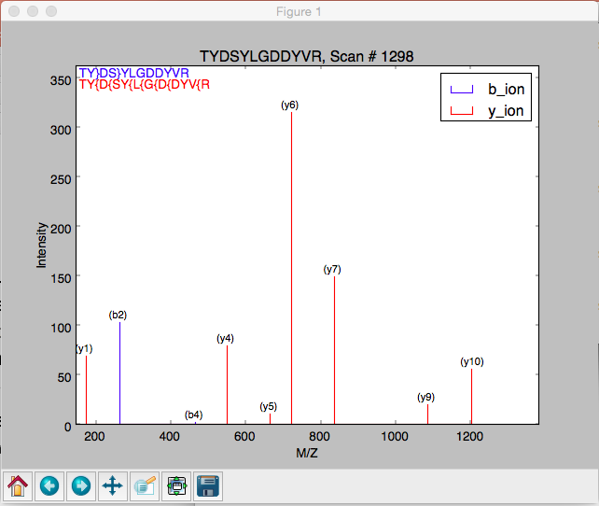
Program Execution
3 Inputs: Compressed Spectra file, peptide sequence, scan number
Output: intensity vs m/z plot
Optional : list of calculated b and y ions
Result Evaluation: Peptide match to spectra determined by plot coverage
Reasonable match show decent coverage of peptide ions by scan points
Annotated sequence
number of lines
Unreasonable match shows little to no coverage

Slide 6
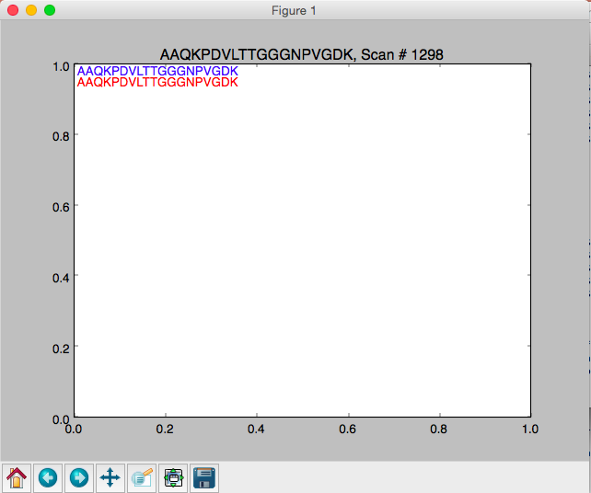
Program Execution
3 Inputs: Compressed Spectra file, peptide sequence, scan number
Output: intensity vs m/z plot
Optional : list of calculated b and y ions
Result Evaluation: Peptide match to spectra determined by plot coverage
Reasonable match show decent coverage of peptide ions by scan points
Annotated sequence
number of lines
Unreasonable match shows little to no coverage

Slide 7
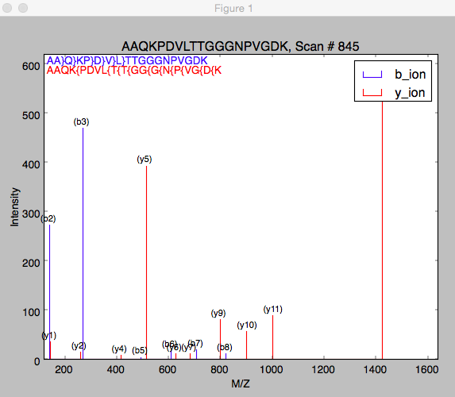
Program Execution
3 Inputs: Compressed Spectra file, peptide sequence, scan number
Output: intensity vs m/z plot
Optional : list of calculated b and y ions
Result Evaluation: Peptide match to spectra determined by plot coverage
Reasonable match show decent coverage of peptide ions by scan points
Annotated sequence
number of lines
Unreasonable match shows little to no coverage
?

Slide 8
Tested Cases:
Tested Inputs:
Command-line Messasges | Consequence
Invalid input order: File, Peptide, Scan number | Exit Program
Invalid input values
No match to either b or y ions | Notify User, empty plot shown
No Match to neither b nor y ions
Peptide | Scan #
TYDSYLGDDYVR0 | 1298, 1301
AAQKPDVLTTGGGNPVGDK | 845
LITAIGDVVNHDPVVGDR | 1503,’4,’5,’6,’7,’8
HSTVFDNLPNPEDR | 1290,’93
IGDGMGDSEITAAR | 1013
HADSVAELGEQIDNLQR | 1455
ITAIGDVVNHDPVVGDR | 1297
ESGYPQVFYGDMYGTK | 1598

Slide 9
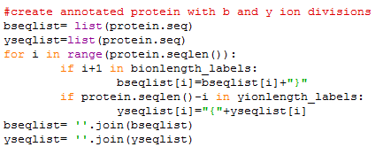
Personal Challenges:
Iteration process to generate correct b and y ion peptide sequences
Familiarization with stem plot and keywords
Removing point marker at top of each line
Annotating each plotted line with respective b or y ion label
These correspond to the position in the sequence, or the length of the corresponding ion
Annotating original peptide sequence with matched ions found in spectrum data

Slide 10
Points of strength and weakness
Strengths | Weakness
Defining the peptide class as Seq sublcass allows for future extendibility but here us unnecessarily redundant
Iterparse allows for direct access to desired element | Iterparse required file to be opened to obtain namespace.
 | Sys needs to be imported in the module solely for the purpose of stopping the program due to invalid input
The program catches a variety of user-input mistakes | The program ability to gather spectra data is specific to file 17mix_test2.mzxml
The variety robustly uses try-error blocks to deal with very incompatible peptide and spectra data pair | For ions found very close in the spectra, the plot will show overlapping and hard to distinguish peaks

Slide 11
Lesson in Bioinformatics
Tradeoff need to be made between accuracy and ability data analysis
The comparison between b and y ion calculation and spectra required the m/z values to be rounded.
Relatively robust analyses can be done without extensive use of strongly typed languages.
Lesson in Programming
Learning programming, or at least python, is really just learning how to look up, understand and use the documentation.
Modules are a useful way to implement scientific concepts into computational validation.

Slide 12
Thank you

